Slide 1
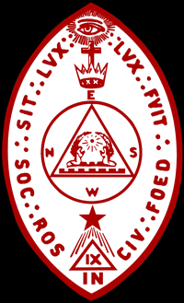
The Language of Alchemy
Part 1
Presented February 28th, 2010 at
Golden State College, SRICF
Los Altos, California
Jordan T. Yelinek, IV˚

Slide 2
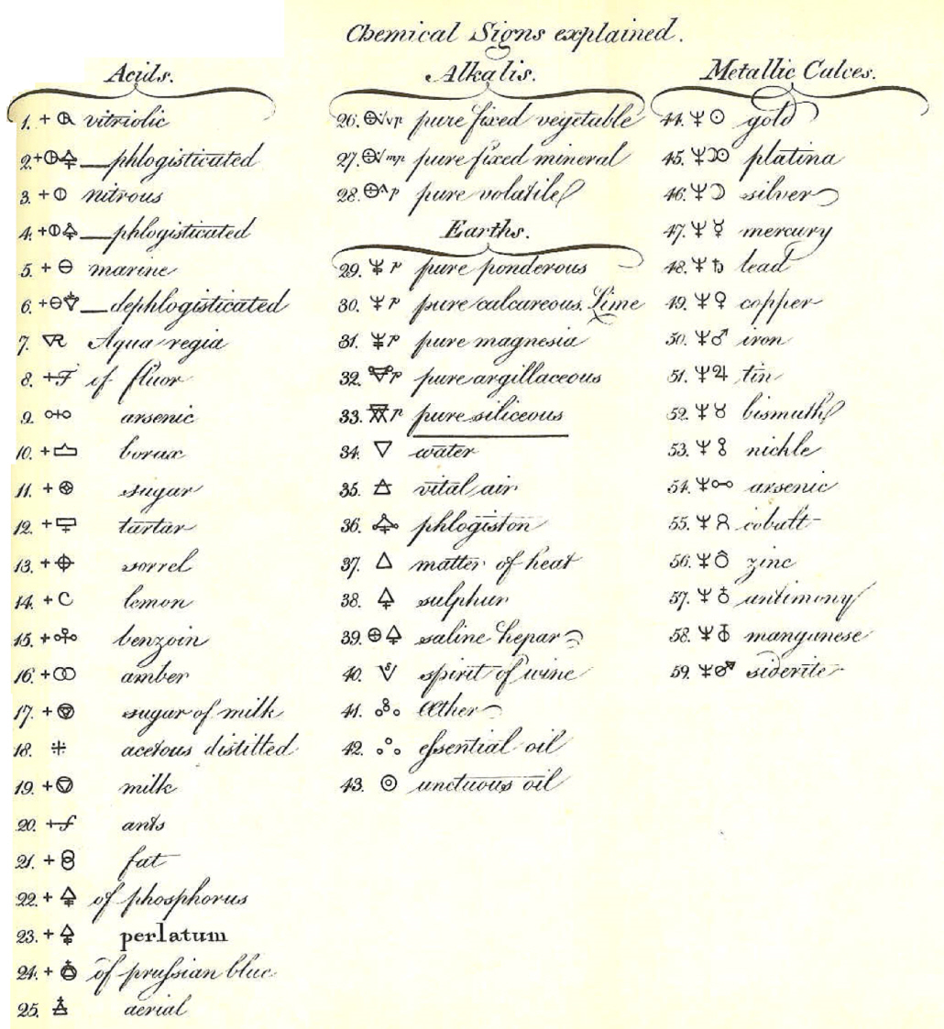
Bergman – Alchemical Symbols (1775)

Slide 3
Historical Alchemists

Slide 4
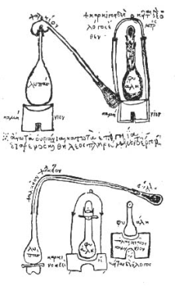
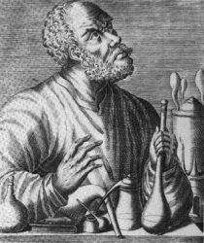
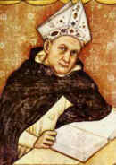
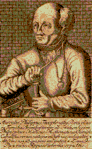
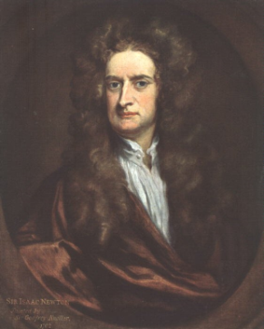
Historical Perspective of Alchemy
Zosimos of Panopolis 250A.D.
Gerber 721 - 815 AD
Issac Newton 1642 - 1727 AD
Albertus Magnus 1200 - 1280 AD
Paracelsus 1493 - 1541 AD

Slide 5


Zosimos of Panopolis
ca. 250AD
Born in Egypt, Greek alchemist
Believed all substances are composed of the four elements of nature - Fire, Water, Air and Earth.
Compiled a 28 volume encyclopedia on khemia (alchemy, chemistry)
Father of Egyptian/ Greek alchemy
Much of the knowledge was destroyed by the Roman emperor Diocletian and Christians who burned the library in Alexandria in 391
Notes:
Process of distillation and hermetic sealing
Formula of the crab – gold and copper were seen as tinted metals, adding tint to metals thought to bring closer to gold, this formula likely uses copper salts… but thought to contain the secrets of transmutation

Slide 6
Geber
Abu Musa Jabir Ibn Hayyan ca. 721 - 815 AD
Arabian alchemist who lived in modern day Iraq
Distilled acetic acid from vinegar
Believed metals are made up of mercury and sulfur in varying proportions
Popularized the idea of the Philosophers stone to combine mercury and sulfur to make gold
The word ‘gibberish’ is derived from his name
Notes:
Mercury and Sulphur theory of metals
Stone described as red ore – cinnabar – heat yields lq. Mercury (quicksilver) and sulphur dioxide gas

Slide 7
Albertus Magnus
Albert von Bollstadt, ca. 1200 - 1280 AD
German monk and practicing alchemist
Followed the works of Aristotle, giving his philosophy prominence in the Middle Ages
First to describe arsenic in its pure form
Thomas Aquinas was one of his students
Notes:
Added philosophy to alchemy

Slide 8
Paracelsus
Philippus Aureolus Theophrastus Bombastus von Hohenheim 1493 - 1541 AD
Name means 'better than Celsus'
Celsus being a renowned Roman scholar of medicine
He invented the word alcohol from the Arabic 'al-kohl’
Invented branch of alchemy called 'spagyric alchemy‘
Believed in spiritual alchemy
Purpose of alchemy was not to transmute metals, but to cure disease
Paracelsus is claimed by the Fraternitas Rosae Crucis to be the true identity of the mythical alchemist Christian Rosenkreutz
Notes:
Tria Prima

Slide 9

Isaac Newton
1642 - 1727 AD
In addition to physics and math, was also accomplished in alchemy.
“First of the age of reason but that he was the last of the magicians.“
Inspiration for work in light and gravity came from alchemy as shown by Royal Society documents
Suggested that Newton succeeded in transmuting lead to gold
Notes:
Modern renown

Slide 10
Alchemical Symbols

Slide 11








Four Basic Elements
Variations on the representation of the Four Basic Elements across different symbolic systems
Greek Classic | Cabbalistic | Tibetan | Element
 |  |  | Fire
 |  |  | Water
 |  |  | Earth
 |  |  | Air
Stupa
Notes:
Variety of symbols used in different types of alchemy
Egyptian, Greek, Persian, Chinese, European
Quintessence

Slide 12

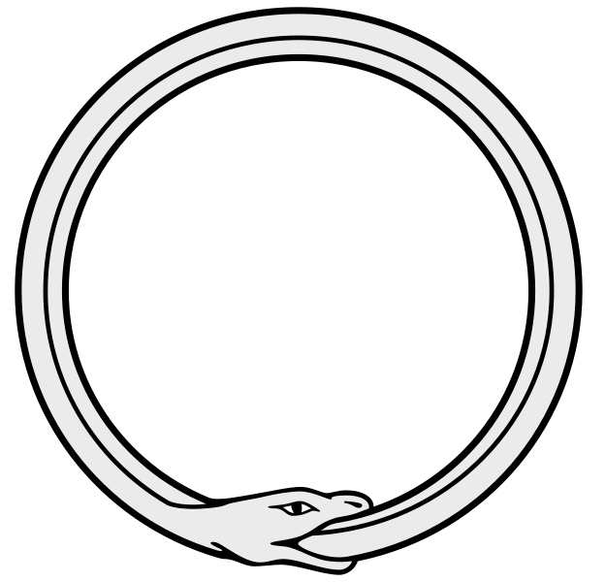


Tria Prima
Paracelsus taught the cosmos were fashioned from these substances, in addition to the four elements
“One is all, and by it all, and to it all, and if one does not contain it all, all is naught”
Symbol | Element
 | Sulphur
 | Salt
 | Mercury
Ouroboros
“Know, then, that all the seven metals are born from a threefold matter… Mercury is the spirit, Sulphur is the soul
and Salt is the body… the soul… unites the two contraries… and changes them into one essence” - Paracelsus
Notes:
Sophic vs Elemental
Philosophy and Elements joined (Gods to locations and attributes)

Slide 13
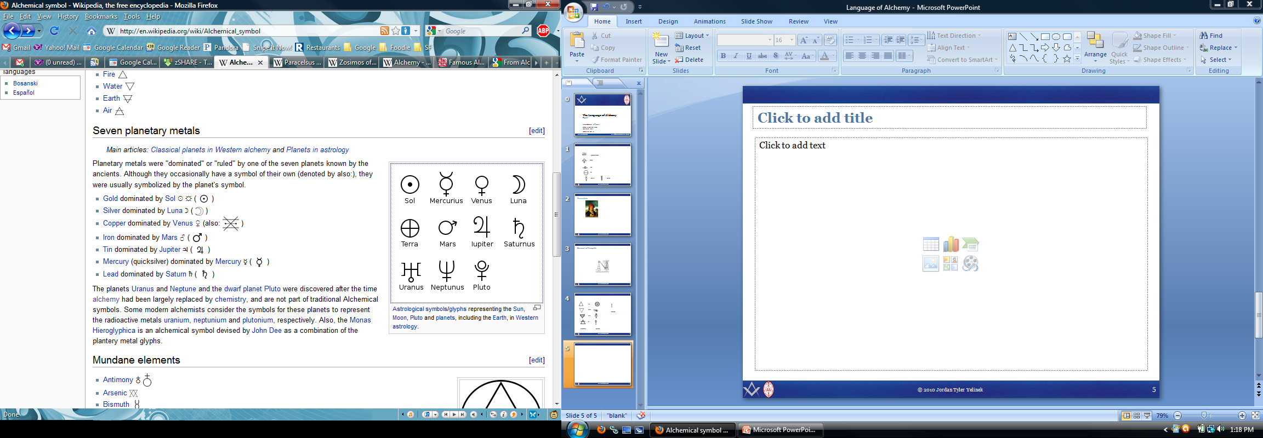
Seven Planetary Metals
Planetary metals were “dominated” by one of the seven planets (known by ancient alchemists).
Symbol | Element | Domination
 | Gold | Sol
 | Silver | Luna
 | Copper | Venus
 | Iron | Mars
 | Tin | Jupiter
 | Mercury | Mercury
 | Lead | Saturn

Slide 14












12 Core Alchemical Processes
These 12 processes are considered to be the basis of the modern chemical processes
Decomposition |  |  |  | Separation
 | Aries | Oxidation |  |  | Virgo | Distillation
 | Leo | Digestion |  |  | Libra | Sublimation
 | Capricorn | Fermentation |  |  | Scorpio | Filtration
Modification |  |  |  | Union
 | Taurus | Coagulation |  |  | Cancer | Solution
 | Gemini | Fixation |  |  | Aquarius | Multiplication
 | Sagittarius | Ceration |  |  | Pisces | Projection

Slide 15
Mundane Elements and Alchemical Compounds
Common elements and compounds found in alchemical writings and formulae
Mundane Elements |  | Alchemical Compounds
Antimony |  | Sal ammoniac
Arsenic |  | Aqua Fortis
Bismuth |  | Aqua Regia
Boron |  | Spirit of Wine
Magnesium |  | Amalgama
Phosphorus |  | Cinnabar
Platinum |  | Vitriol
Potassium
Stone
Sulfur
Zinc

Slide 16
Symbolic Alchemy

Slide 17




Lapis philosophorum
A sign for the lapis philosophorum, the Stone of Wisdom, the prerequisite for the wished end result of the alchemical process.
The Stone of Wisdom partook in the nature of the quinta essentia or quintessence, that is the fifth element after those of earth, water, air and fire. Therefore signs for the quintessence are somewhat synonymous with signs for the lapis philosophorum.

Slide 18

Lapis philosophorum
 | Passage of time Protection (angelic wings) | Year
 | Binding agent between substance & transformation (flammability) (air and fire) Soul (emotions and desires) | Sulphur
 | Solidifying agent (fixity and non-combustibility) (earth) Body (physical and present) | Salt
 | Transformative agent (fusibility, liquidity, volatility) (water) Mind (imagination, moral judgment, higher faculties). | Mercury
Notes:
Alchemists were always very interested in the fluid metal mercury (a close relative to gold, mercury having the atom number 80, gold having 79). Mercury could dissolve other metals and combine itself with them into amalgams, .
Sophic (our) vs Elemental
Masculine and Feminine
Osiris and Isis
Lion and lioness
Sun and moon
Fire and water
Mind and spirit
Made union through that which is inflexible… man
Greek theory that opposites are impossible to join (sophic or elemental)
Philosophy and Elements were joined

