Slide 1
The Curious Case of the Second Degree
Bill Miklos, PM, KYCH

Slide 2
The Curious Case of the Second Degree
The manner of the second degree shall be examined.
Was there always a second degree?
What does the word degree mean?
What events may have shaped the second degree?
Who was responsible (if any) for the second degree?
Why did the second degree change or did it?

Slide 3
The Curious case of the Second Degree
In the beginning, there was only one degree, that of Apprentice.
The “fellow-0f the Craft,” was not a degree at all, but was contained in multiple old manuscripts.
Generally, “fellow of the craft” was an apprentice who had been a mason for a period of time and “learned” more (fellow of the craft).
An apprentice could not be a master, but a fellow of the craft could.
Interesting enough, these old manuscripts were deeply Catholic and overtly so.

Slide 4
Religion
The next slides will show a couple of things; just how deeply religious Masonry was,
The more practical side, and
The notation of the seven liberal arts and sciences.

Slide 5
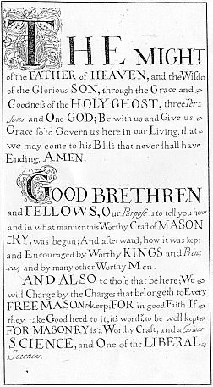
The Old Charges
Dumfries Manuscript #4
Originally written in 1710
The almighty father of holiness the wisdom of the glorious jesus through the grace of the holy ghost these being three persons in one godhead qm we implore to be with us at the beginning & give us grace so to govern our selves hear in this mortal life towards him that we may come to his kingdome that shal never have end. Amen.
Imprimus You shall serve the true god and carefully keep his precepts in general particularlie the Ten words delivered to Moses on mount Sinai As you have them explained in full on ye pavement of the Temple.
Secondly You shall be true & stedfast to ye holy catholick church (4) and shun all herise & shisim or eror to your wnderstanding.

Slide 6
You shall keep a true and faithfull corespondance with all those masters and Fellows of Mesonry that you know to be legally entred in orders there secrets you shall keep there loss you shall withstand to your power them honour and cridit you shall maintain.
There ar seven libral Sciences ye first is divi[nity] wc teacheth ye logical virtues the 2d is gram[mar] joined to Rhetorick wc teacheth Eloquence & how to speak in subtill tearms ye 3d is philosophy wc is lovers of wisdom by wc is brought both ends of a contrdiction together. & crocke[d] things made straight black grouen white by a Rule of contrarities &c the 4th is musick yt teacheth songs harps & organs wt all other sort[s] of vocal instrumentel musick it is to be mi … ye forsd Science hath neither medium nor end ye 5th is logick yt discovereth truth from falshode & is guide [to] judges & lawiers ye 6th is geometry yt teacheth to measure material heavens with al earthly dementions & all things contained yrin ye 7th & last is of the Scienceiss astronomy wt astrologie yt teacheth to know ye course of ye su[n] moon & stars ornaments of the heavens ye 7 scieneces al suporte by geometry by wc we cunclude yt Science most worthy yt giveth [word omitted in MS.] & aid to the Rest yt is yr is no man yt worketh in any craft but he worketh by some measure & al of geometry for it serves to weight & measure al maner of things on earth especially plughm[e]n & tillers of ground for corn & seeds vines & flouers plants & other for non of ye Rest doe serve men to measure without geometrie

Slide 7
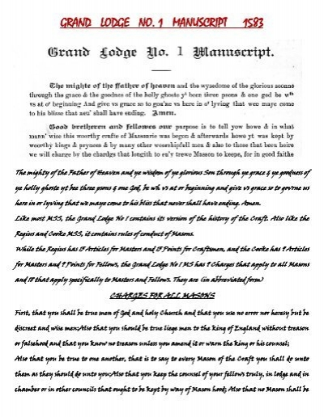
The Old Charges, (1593)
Grand Lodge Manuscript # 1

Slide 8
Newtonian Philosophy
“Despite the influence of Newton's “method” on eighteenth-century philosophy, it is obvious that the Principia's greater impact on the eighteenth century is to have effected a branching within natural philosophy that led to the development of mathematical physics on the one hand, and philosophy in the other. And yet to achieve an understanding of how Newton himself approached natural philosophy”
Stanford Encyclopedia of Philosophy, Newton’s Philosophy first published in October 13, 2006, substantial revision May 6, 2014.

Slide 9
Natural Theology and Natural Religion
In contemporary philosophy, however, both “natural religion” and “natural theology” typically refer to the project of using the cognitive facilities that are “natural” to human beings---reason, sense perception, introspection—to investigate religious or theological matters”
In general, natural religion or theology aims to adhere to the same standards of rational investigation as other philosophical and scientific enterprises, and is subject to the same methods or evaluation and critique.
Stanford Encyclopedia of Philosophy published 6/6/2015 page 1

Slide 10
Merry Old England @1698-1730
Margaret C. Jacob, in her book “The Radical Enlightenment, Pantheists, Freemasons and Republicans,” suggested that “men like Taylor and Desaguliers ensured that the official Masonry of the Grand Lodge was piously Christian and vaguely Protestant.” Newtonian Natural Philosophy had been introduced into English society by the 1680’s and under Desaguliers was made available to the rank and the The Radical Enlightenment, Margaret C. Jacob Cornerstone Book publishers, ISBN 978-1-887650-74-0 page 83

Slide 11
Merry Old England @1698-1730
    …file of the Masonic lodges as well as aristocrats, bourgeois and gentlemen. But what evidence do we offer to the reader to assert such a claim?
“It can be said that Newtonian Enlightenment gave birth to speculative Masonry, there was also an important and decisive contribution made by the radicals.” “Likewise its essentially social nature, reinforced by the trappings of secrecy, gave an extraordinary sense of community to men who were disaffected from church and chapel. Alternatively, among Christian and Newtonian promoters, led in particular by John Theophilus Desaguliers, organized Freemasonry served as a social nexus that promoted specific cultural and ideological goals: stability under a strong constitutional monarchy, social mobility under aristocratic patronage, regions toleration, Baconian experimentalism and, of course dedication to the cult of the new science,” As further evidence, Samuel Clarke exhorted, “ that the most universal principle of gravitation itself, the spring of almost all the great and regular inanimate motions in the world…is…an evident demonstration that (the world) depends every moment on some superior being, for the preservation of its frame…and (this demonstration) does...give us a very noble idea of providence”
The Newtonian Enlightenment had already permeated throughout England and Dr. John Theophilus Desaguliers unabashedly promoted it both with the Royal Society and Freemasonry.
Ibid page 80
Ibid page 80
Ibid page 64

Slide 12
After the removal of King James II from the throne in 1688, the populace as a whole felt empowered to take more interest in the affairs of he nation, for there was now the possibility of open discussion of mattes political and religious without immediate fear of repercussion. Men, and very occasionally women, came together to debate all manner of topics.
John Theophilus Desaguliers, Audrey T Carpenter 2011 ISBN: PB 978-1-14411-2778-5 page 25
“Interaction developed between people who previously would have been confined within their limited private circles and social status created by wealth and inherited rank began to be marginally less important. Gentlemen of the aristocracy and the gentry would mix with those of the social middle class from doctors and lawyers to successful tradespeople.”
Ibid page 26

Slide 13
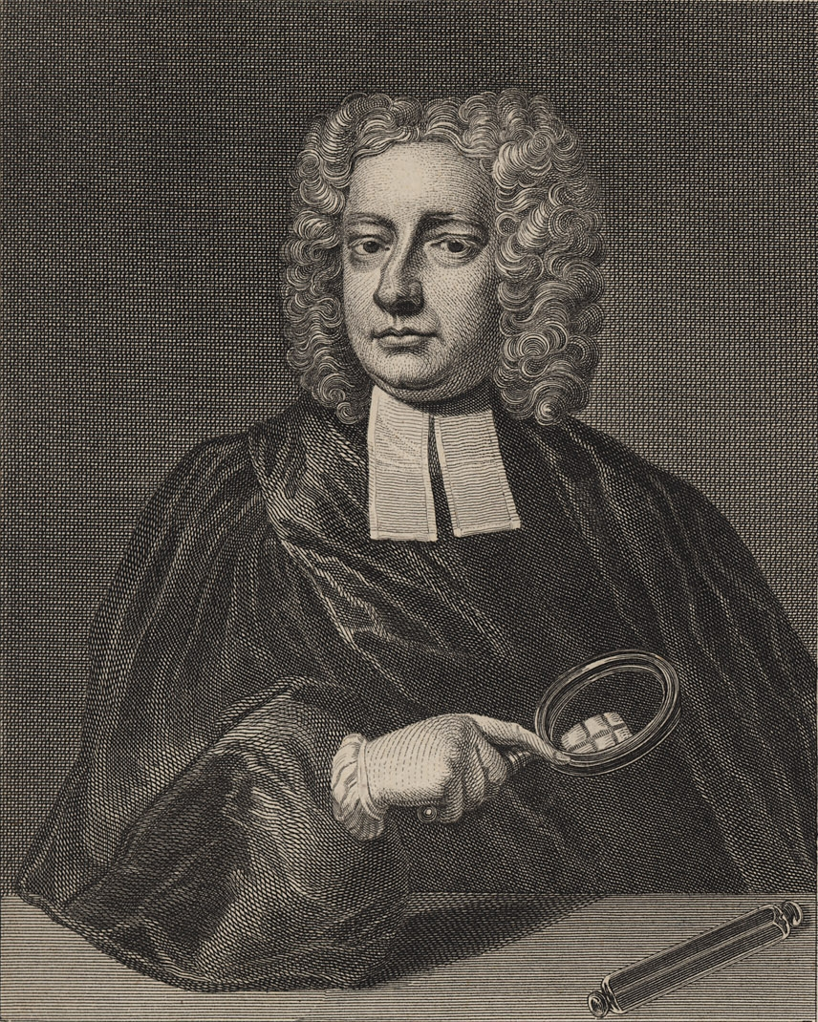
John Theophilus Desaguliers

Slide 14
Desaguliers
John Theophilus Desaguliers was perhaps the most well known and successful lecturer and demonstrator of his time. His lectures on experimental philosophy in England were well received among the his peers at Oxford, and Cambridge along with the Royal Society.
He was a Natural Philosopher, Engineer and Freemason.
Charles Lennox, Second Duke of Richmond and Duke of Aubigny was Grand Master in 1724-25 and both were members of lodge # 4 in London and he accompanied Desaguliers to Pairs in 1735 for the inauguration of the Lodge at the Hotel de Bussy.

Slide 15
Dumfries Manuscript # 4 (1710)
THE MANER HOW IT FIRST BEGAN
There are seven libral Sciences ye first is divi[nity] wc teacheth ye logical virtues the 2d is gram[mar] joined to Rhetorick wc teacheth Eloquence & how to speak in subtill tearms ye 3d is philosophy wc is lovers of wisdom by wc is brought both ends of a contrdiction together. & crocke[d] things made straight black grouen white by a Rule of contrarities &c the 4th is musick yt teacheth songs harps & organs wt all other sort[s] of vocal instrumentel musick it is to be mi … ye forsd Science hath neither medium nor end ye 5th is logick yt discovereth truth from falshode & is guide [to] judges & lawiers ye 6th is geometry yt teacheth to measure material heavens with al earthly dementions & all things contained yrin ye 7th & last is of the Scienceiss astronomy wt astrologie yt teacheth to know ye course of ye su[n] moon & stars ornaments of the heavens ye 7 scieneces al suporte by geometry by wc we cunclude yt Science most worthy yt giveth [word omitted in MS.] & aid to the Rest yt is yr is no man yt worketh in any craft but he worketh by some measure & al of geometry for it serves to weight & measure al maner of things on earth especally plughm[e]n & tillers of ground for corn & seeds vines & flouers plants & other for non of ye Rest doe serve men to measure without geometrie.

Slide 16
Grand Lodge Manuscript # 1
GOOD BRETHREN and fellows, our purpose is to tell you how and in what manner this worthy Craft of Masonry was first begun and afterwards how it was kept and upheld by worthy kings and princes, and many other worshipful men. And also, to those that are here, we will declare the Char­ges that belong to every true Mason to keep in good faith; and therefore take good heed to it, for it is a Science that is worthy of being kept, for it is a worthy Craft; and is one of the seven liberal Sciences.

Slide 17
Grand Lodge Manuscript # 1(1593)
The names of the seven liberal Sciences are:
• The first is Grammar that teaches a man to speak and write truly;
• The second is Rhetoric that teaches a man to speak well, in subtle terms;
• The third is Dialectic [Logic] that teaches a man to discern truth from falsehood.
• The fourth is Arithmetic that teaches a man to reckon and count all kinds of numbers;
• The fifth is Geometry that teaches a man to mete and measure the earth and all other things, which Science is called Geometry (1).

Slide 18
Grand Lodge Manuscript # 1(1593)
• The sixth Science is called Music that teaches a man the Craft of song and voice of tongue, organ, harp and trumpet.
• The seventh Science is called Astronomy that teaches a man to know the course of the sun, the moon, and the stars.
THESE are the seven liberal Sciences, which are all grounded upon one, that is to say Geometry. And a man may prove that the Science of the world is grounded upon Geometry, for it teaches a man the measure, consideration, and weight of all things on earth; for there is no man who can work any Craft, if he does not work by some measure or weight; nor any man who buys or sells but by some measure or weight, and all this is Geometry.

Slide 19
Grand Lodge Manuscript # 1(1593)
Merchants and all Craftsmen, and others who use the seven Sciences, and especially the ploughmen and tillers of all types of grains and seeds, the planters of vineyards and setters of other fruit: for none can act without Geometry; neither in Grammar, Rhetoric, or Astronomy, nor in any of the others, can any man find length or measure without Geometry. So I think this Science may well be called the most worthy Science, for it is the foundation of all others.

Slide 20
The New Degree
Ashes from the prior materials as noted already.
Dr. Desaguliers and Anderson, with assistance from George Sawyer crafted the degree around the year 1719.
How?
Mackey’s in his Invention of the Degrees of Freemasonry noted that the earliest Fellow craft degree appears in Scotland around 1720.

Slide 21
Invention of the Degrees of Freemasonry,
Mackey Page 14, 16, & 17
The “fellow-craft degree preceded the “Master Masons degree by three or four years which suggest that it was created as early at 1719.
Bro. Lyon, in his history of the lodge at Edinburgh cites a record containing the minutes of the Lodge at Dunblane dated December 27, 1720 which demonstrate the Second degree had already been originated.
The Theoretic members who wanted a more intellectual ritual prevailed over the operatives as the Institution of Freemasonry assumed it current form.
It was highly probable that the degree was integrated into the ritual after June 24, 1719, by Desaguliers, Grand Master with the aid of George Sayer.

