Slide 1
That religion that all men can agree?
A debate between Gentlemen;
Albert Pike and JOHN THEOPHILUS DESAGULIERS

Slide 2
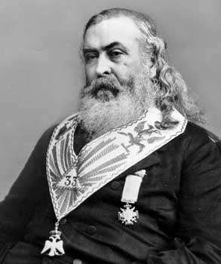
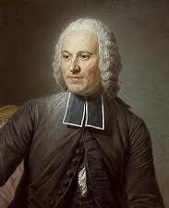


That religion that all men can agree?
Brother Albert Pike and
Brother JOHN THEOPHILUS DESAGULIERS

Slide 3
The central question is:
1717-38 versus 1865-70
“yet ’tis now thought more expedient only to oblige them to that Religion in which all Men agree, leaving their particular opinion to themselves” (Andersons constitutions 1723)

Slide 4
John Desaguliers Third Grand Master 1719, Deputy Grand Master 1723,1725 (The Background).
Lets examine the time period of Desaguliers.
Recently ended a bitter religious battle between the Catholic Church and The Protestant Church (thirty years war and a civil war).
Desaguliers was a Huguenot (from his Fathers upbringing) and a Protestant Cleric.
The New Hanoverian dynasty was just starting and religious and political tensions were strained. The Jacobite threat was viewed are real.
Lecturer and Promoter of Newtonian Experimental Philosophy
Demonstrator at the Royal Society

Slide 5
Albert Pike, Ancient Free and Accepted Scottish Rite (The Background)
From Escoterika (page 300 & 301) we find this about Albert Pike:
“A right to Freedom of Thought and Action that all men are equal in God’s sight.”
A god loving his creatures. Jesus of Nazareth
Deeply religious in that he argued in:
Morals and Dogma?

