Slide 1

When God Abandoned Rome
John L. Cooper III, IXº
Notes:
Today’s presentation is a summary of a paper that I wrote for Golden State College, SRICF, and which will be available in a final, edited copy online at our website after today’s discussion.
The Fourth Century in the Roman Empire was one of significant transition, not only for Roman society in general, but for the nascent Christian Church which was now some three hundred years old at the beginning of the century.
The century opened with the largest and most devastating persecution of Christians and their churches, and ended with the Catholic Church as the sole official religion of the empire.

Slide 2
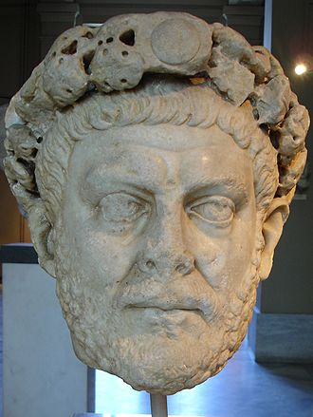
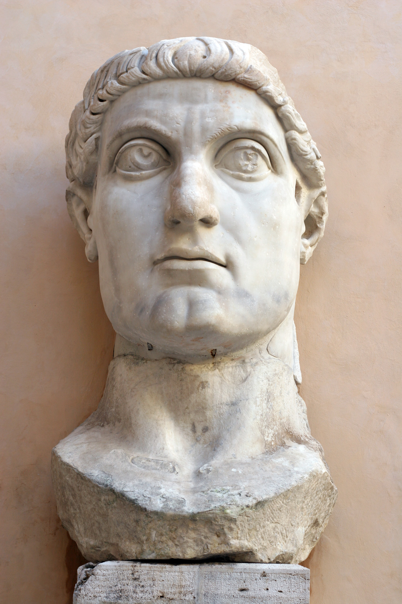
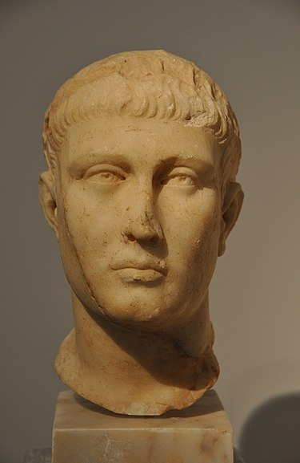
A Fourth Century Tragedy

Slide 3
Diocletian
Emperor, 284-305 A.D.

Slide 4
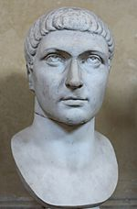
Constantine the Great
Emperor, 306-337 A.D.

Slide 5
Theodosius the Great
Emperor, 379-395 A.D.

Slide 6
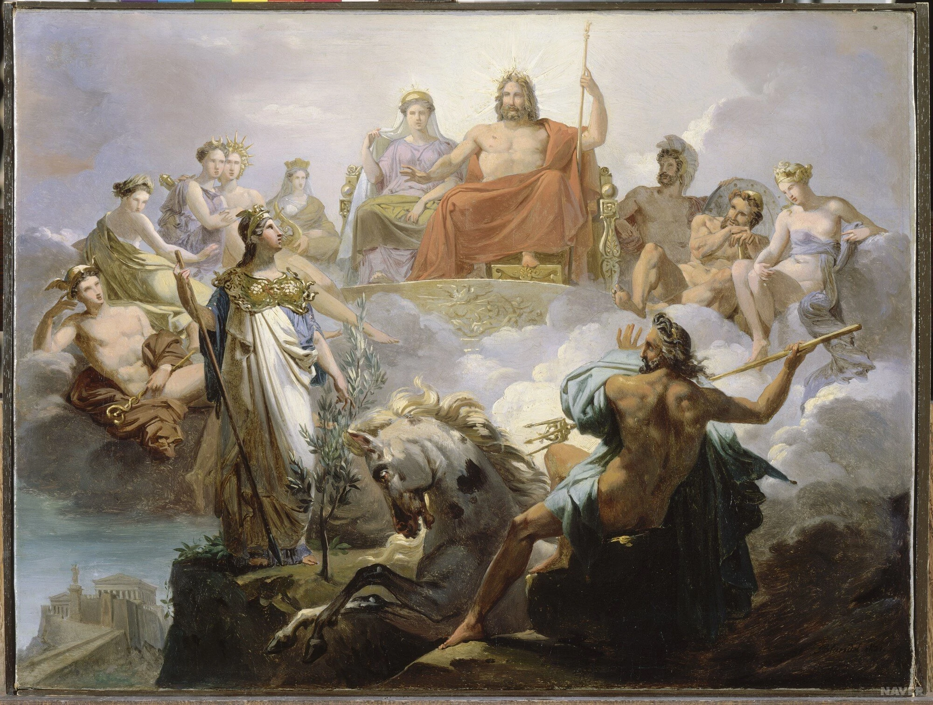
The Diocletian Persecution

Slide 7
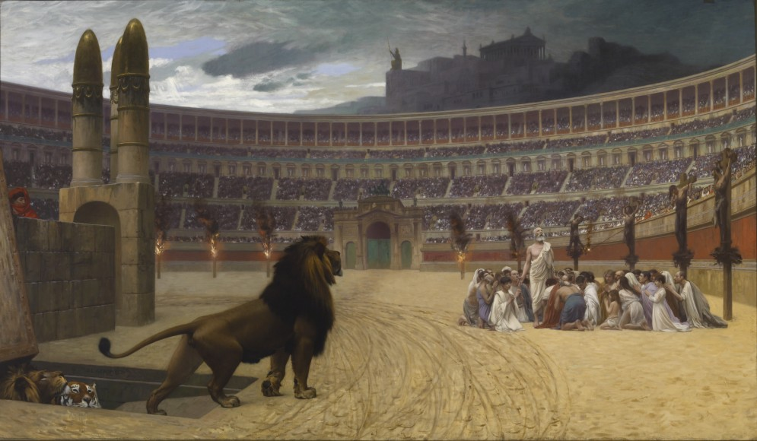
The Diocletian Persecution

Slide 8
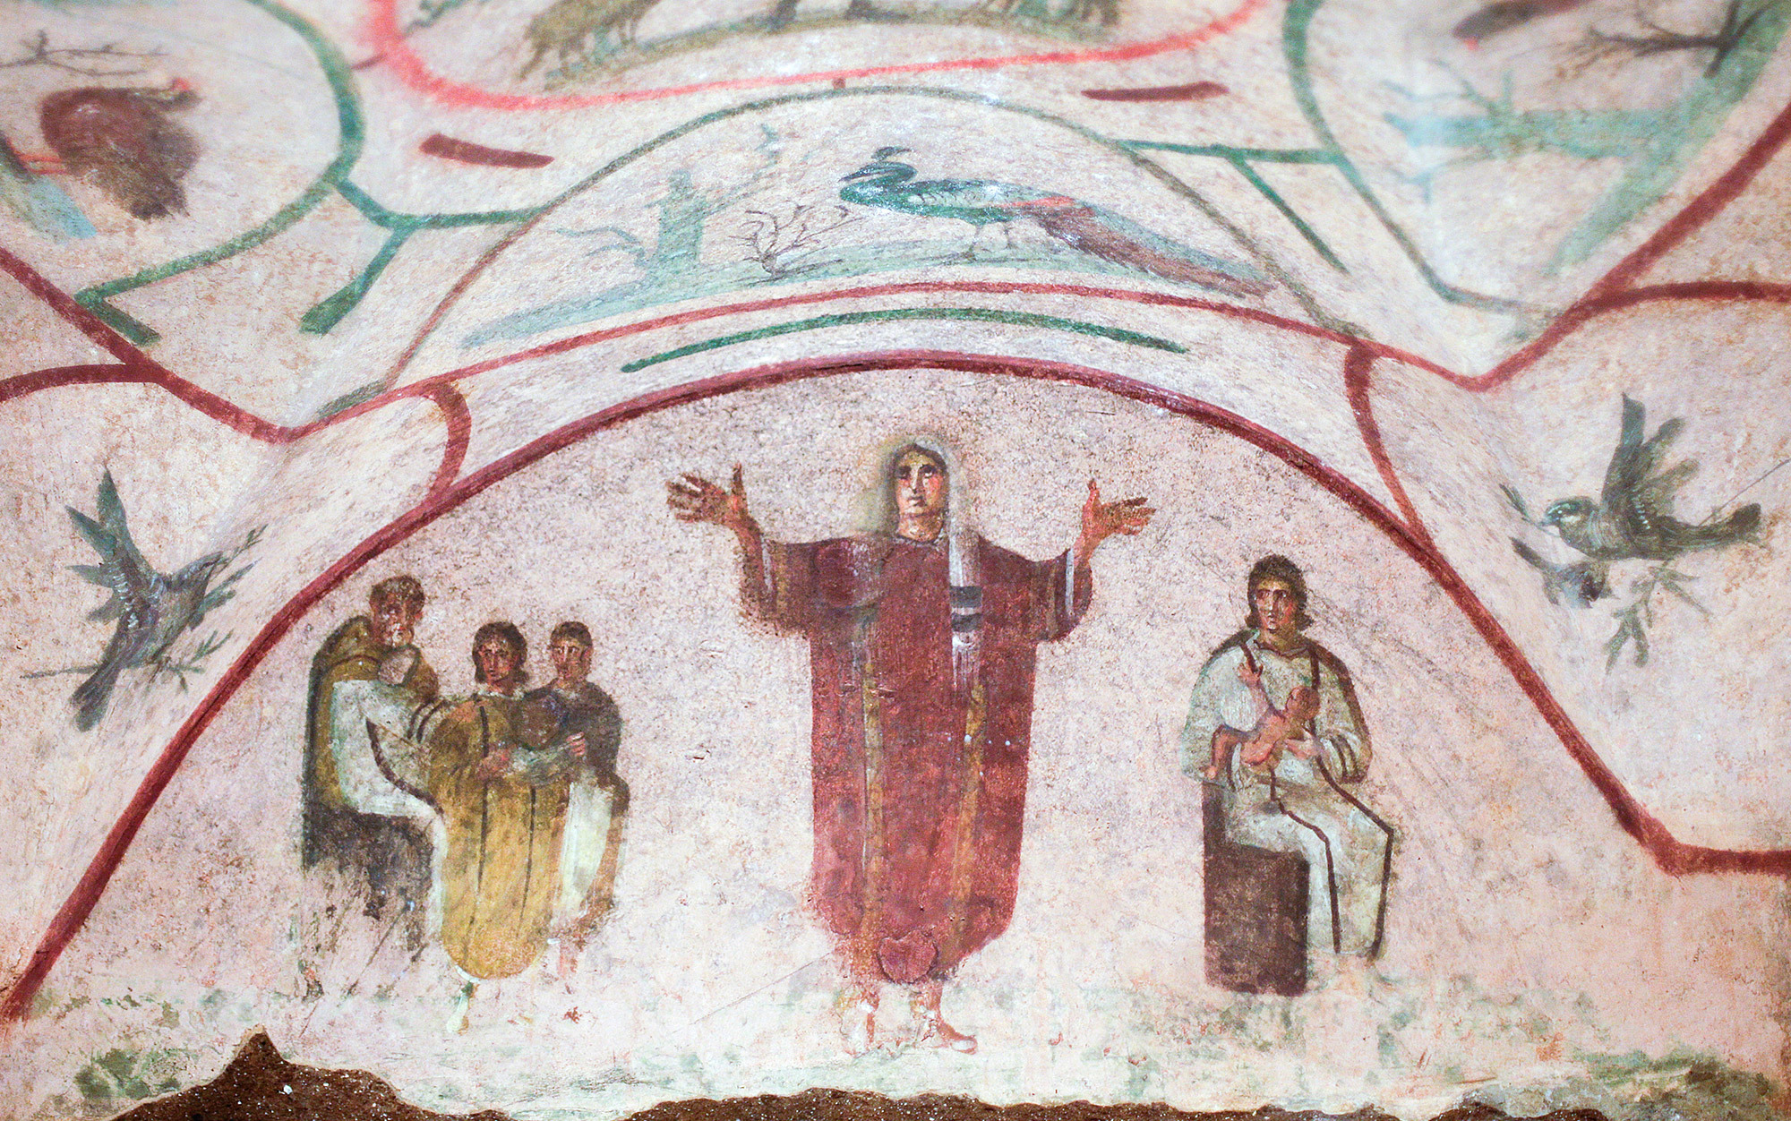
Edict of Serdica
311 C.E.

Slide 9
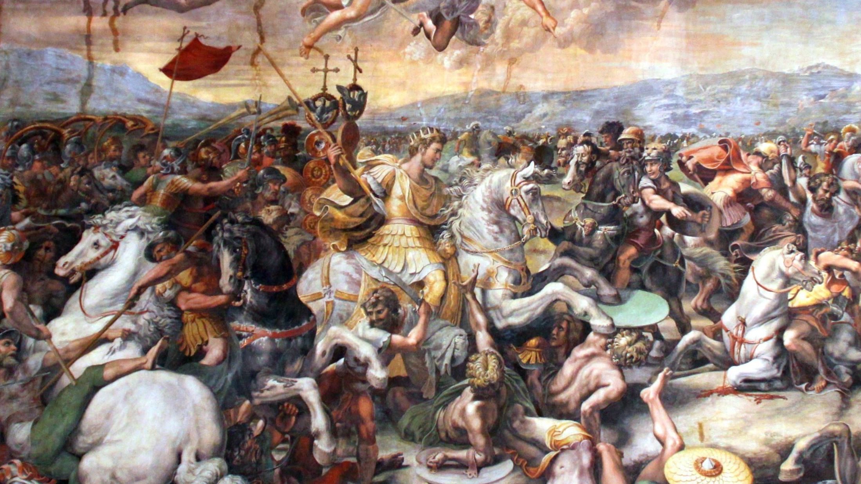

Slide 10
“Edict of Milan”
When we, Constantine Augustus and Licinius Augustus, met so happily at Milan, and considered together all that concerned the interest and security of the State, we decided ... to grant to Christians and to everybody the free power to follow the religion of their choice, in order that all that is divine in the heavens may be favorable and propitious towards all who are placed under our authority.

Slide 11
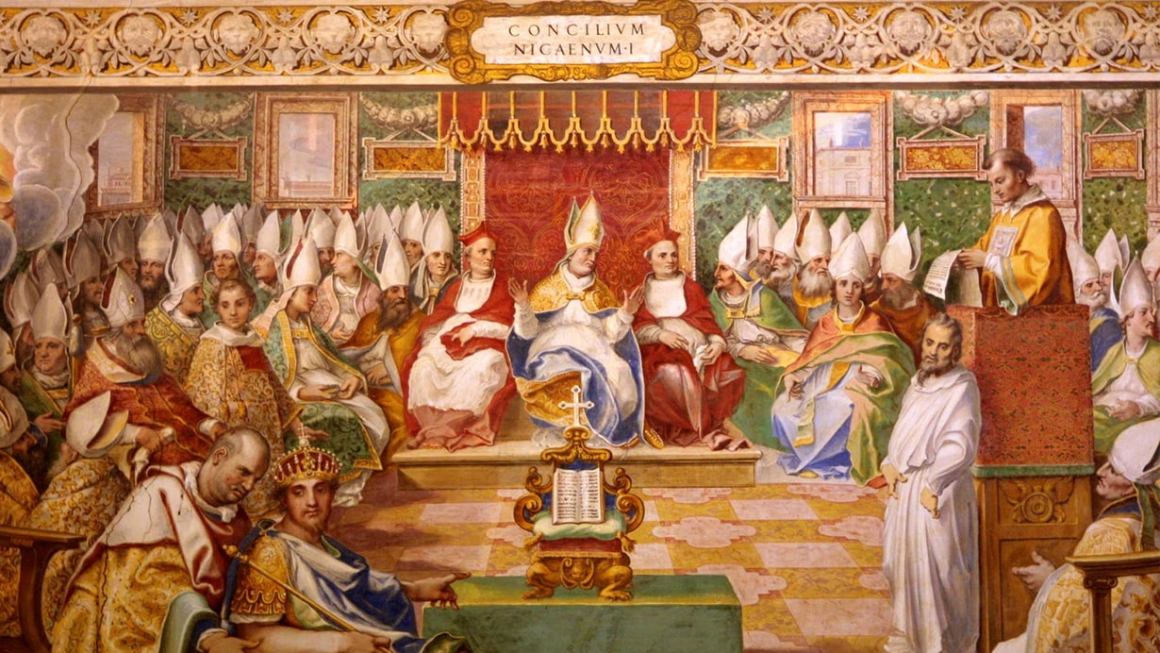
Council of Nicaea

Slide 12
Between Constantine & Theodosius
Constantine the Great (306-337)
Constantine II (337-340)
Constans I (337- 350)
Constantius II ( 37- 361)
Magnentius (350-353)
Nepotianus (350 [27 days])
Vetranio ( 350 [9 months 24 days])

Slide 13
Between Constantine & Theodosius
Julian (361-363)
Jovian (363-364)
Valentinian I ( 364-375)
Valens (364-378)
Procopius (365-366)
Gratian (367- 383)
Valentinian II (375-392)

Slide 14
Theodosius the Great
Emperor, 379-395 A.D.

Slide 15
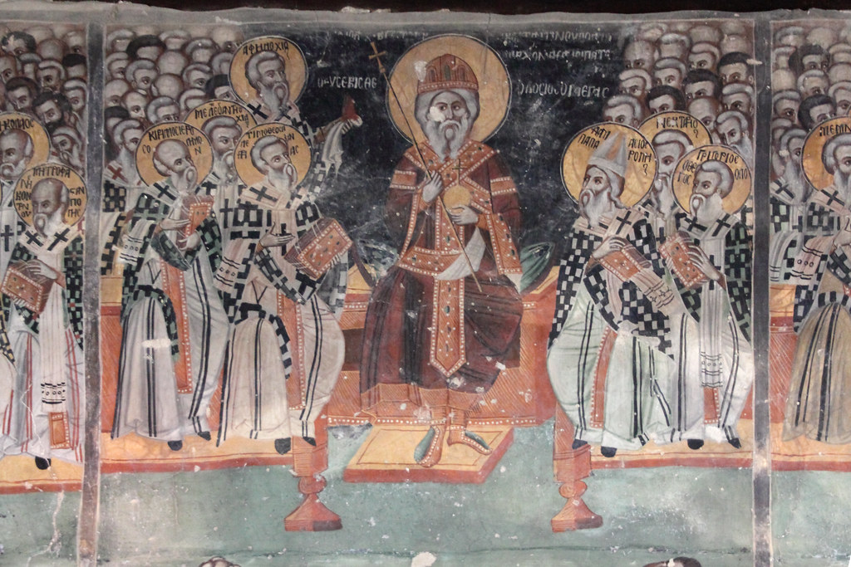
First Council of Constantinople
A.D. 381

Slide 16
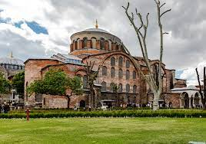
Hagia Irene, Constantinople

Slide 17
Edict of Thessalonica
EMPERORS GRATIAN, VALENTINIAN AND THEODOSIUS, AUGUSTI. TO THE PEOPLE OF CONSTANTINOPLE.
It is our desire that all the various nations which are subject to our Clemency and Moderation, should continue to profess that religion which was delivered to the Romans by the divine Apostle Peter, as it has been preserved by faithful tradition, and which is now professed by the Pontiff Damasus, and by Peter, Bishop of Alexandria, a man of apostolic holiness.
A.D. 380

Slide 18
Edict of Thessalonica
According to the apostolic teaching and doctrine of the Gospel, let us believe in the one deity of the Father and of the Son and of the Holy Spirit, in equal majesty and in a holy Trinity. We order the followers of this law to embrace the name of Catholic Christians; but as for the others, since, in our judgment they are foolish madmen, we decree that they shall be branded with the ignominius name of heretics, and shall not presume to give their conventicles the name of churches.

Slide 19
Edict of Thessalonica
They will suffer in the first place the chastisement of divine condemnation and in the second the punishment of our authority which in accordance with the will of Heaven we shall desire to inflict.
Codex Theodosianus, xvi.1.2

Slide 20
Consequences of the Edict
In January, 381 “heretics” were forbidden to settle in the cities of the empire.
In 381 the proconsul of Asia (western Turkey today) was ordered to deliver all the churches in his province to Nicene bishops, expelling any bishop that was a “heretic.”
In 383 Theodosius required all non-Nicene “sects” to deliver to him a written copy of their “creeds.” He burned almost all of them as “heretical.”

Slide 21
Consequences of the Edict
Non-Nicene Christians were forbidden by law to assemble in their “churches,” forbidden to ordain priests, and forbidden to spread their beliefs to others.
Priscillian, the non-Nicene Bishop of Ávila, in Spain, was arrested and executed by the state.

Slide 22
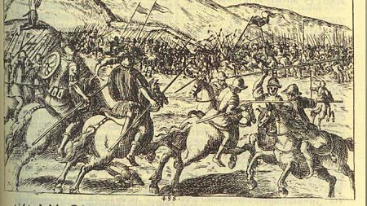
The Battle of the Frigidus River
September 5 & 6, A.D. 394

Slide 23
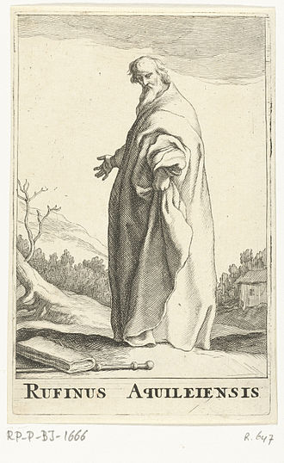
Pagans vs. Catholics
Tyrannis Rufinus

Slide 24
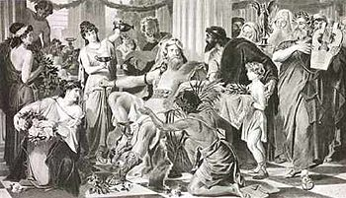
Alaric the Goth
The Sack of Rome, A.D. 410

Slide 25
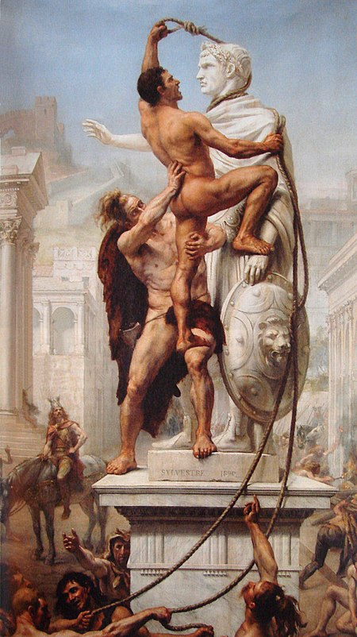

Slide 26
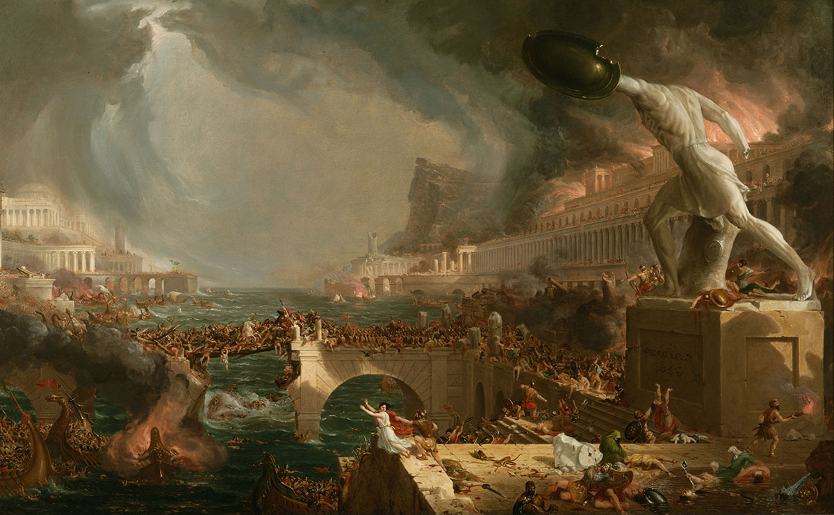

Slide 27
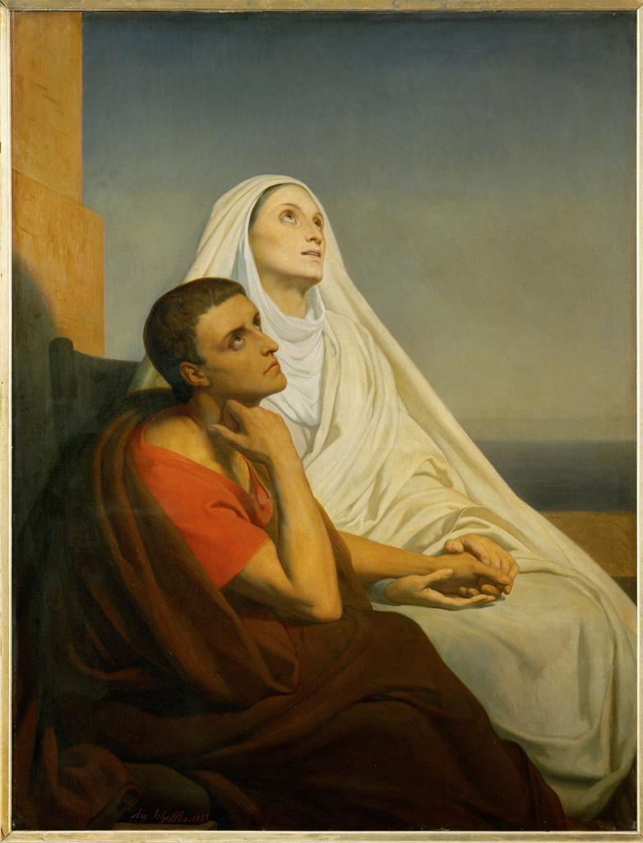
Augustine
with his mother, Monica

Slide 28
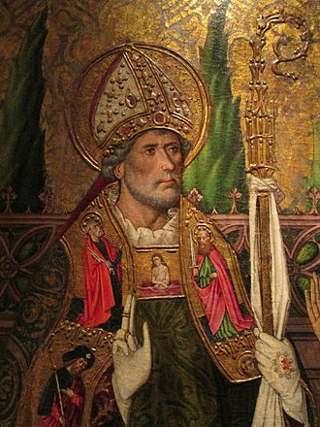
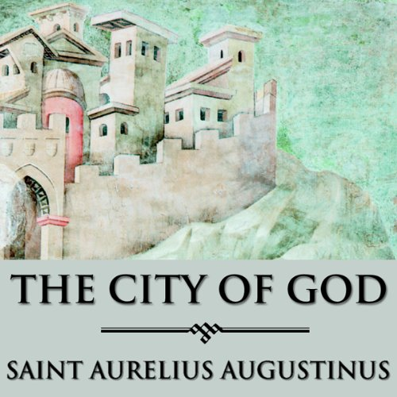
St. Augustine

Slide 29
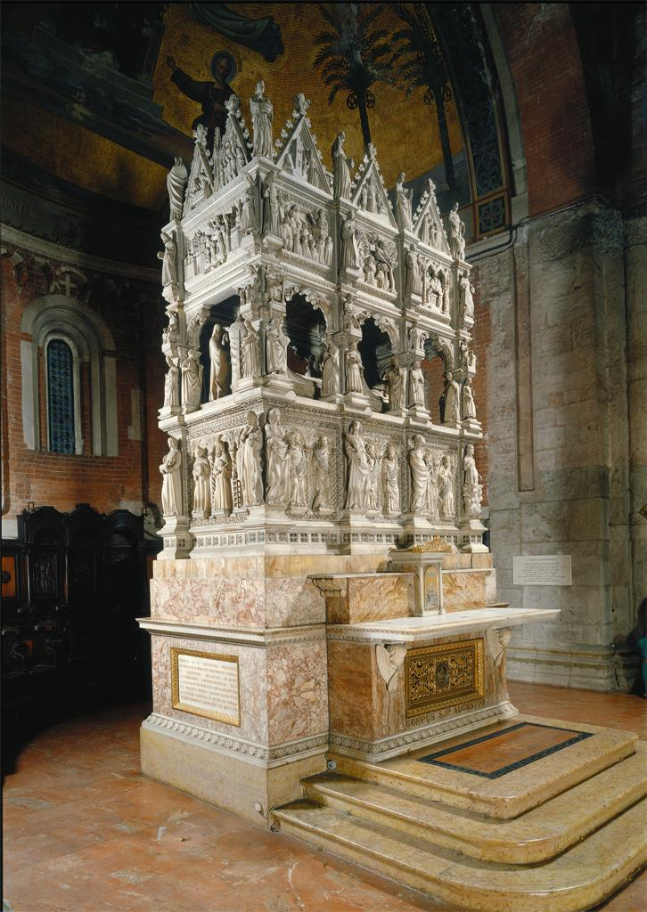
Tomb of
St. Augustine
Pavia, Italy

Slide 30
Some Questions to
Think About

Slide 31
Why was it important
to have only one
“True Church”
?

Slide 32
How did these Christians
determine which was
The “True Church”?

Slide 33
Why did the government
have to get involved
in determining the
“True Church”?

Slide 34
Are there any Masonic
lessons to be
learned from this story?

Slide 35

John L. Cooper III, IXº

